Slide 1
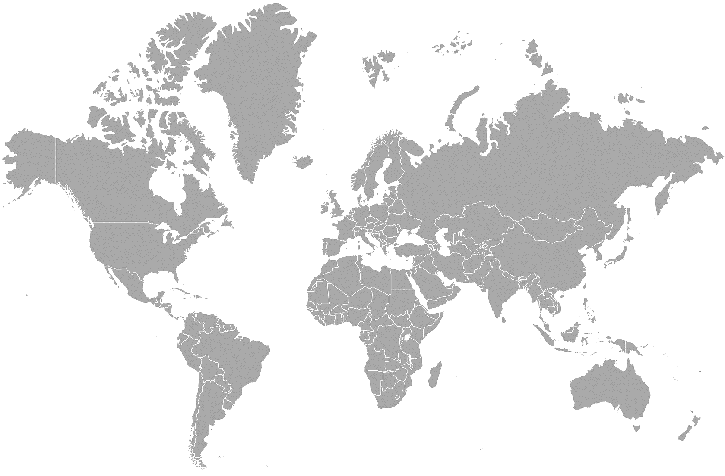

Parallel or Shadow Institutionality
China
(Beijing)
Revisionism Orientation
B
China (Beijing)
Ambivalent Scenario
Foreign Policy
Coupling
Orientation
A
D
A
Process of adoption of the prevailing institutional framework and status quo as a passive actor in the international system.
B
Process of redefinition of existing and established institutions as an active member of the international system.
D
It seeks to preserve international peace, strengthen national security vis-à-vis other countries and promote cooperation between different states in the economic, commercial and cultural spheres.

Slide 2
Relating Guidelines
Regulatory Sources
Related Clarifications
In this case the GATT legal system and all its XXXVIII articles. The Legal Texts of (1986-1994) and its more than 60 agreements plus any new texts arising from Ministerial Conferences and Rounds of Negotiations.
International Agreements
All those international treaties signed and ratified with other countries in order to achieve a series of common objectives.
In this case, a Full Member of the WTO since 2001 and responsible for the rules contained in the GATT 1947 updated in 1994.
International Treaties
Constitution of the People’s
Republic of China
Nominally the supreme law of the State acting as the fundamental rule of structural character that allows to organize the State, acting as the guide that orients its governance.
1
It has 138 articles divided into four chapters: General Principles, The Fundamental Rights and Duties of Citizens, The Structure of the State and The National Flag, the National Anthem, the National Emblem and the Capital.
It has new revisions in 1988, 1993, 1999, 2004 and 2018. It is the fourth constitution in the country's history, after those of 1954, 1975 and 1978.
Constitution
2
Foreign Trade Law
Its purpose is to open, develop and maintain the foreign trade order, protecting the rights and legitimate interests of internationalized traders and promoting the development of the market economy.
It has XI chapters and 70 articles that regulate the import and export of goods and technologies, as well as the international trade of services such as intellectual property.
Adopted on May 12, 1994, and entered into force on July 1, 1994, with a revision in 2004.
Laws
3
Customs Law
This law seeks to strengthen supervision and control by Customs, promoting exchange with foreign countries in economic, trade, science, technology and cultural matters.
It has VII chapters and 61 articles defining customs procedures and the legal status of products entering or leaving the Chinese national customs territory.
Adopted on January 22, 1987, entered into force on July 1, 1987, and revised in 2000.
Provisional Arrangements
Regulation on import and export tariffs
This seeks to implement the policy of openness to the outside world and promote the development of foreign economic relations and the national economy. It also publishes the customs duties for each merchandise.
4
- Adopted on October 29, 2003, and entered into force on November 23, 2003.
- It is integrated with the existing Harmonized System (HS) of July 1, 1992, with annual updates until 2023.
It has VI chapters and 67 articles that seek to regulate the collection of customs duties and procedures. It is adapted to the Harmonized System of the World Customs Organization (WCO) and its XXI sections and 98 chapters.
Local Regulations
Standards
Formulated by the government in different spheres of power.
5
Rules
A
B
Local
Local Formulated by provincial governments or autonomous regions with greater authority than those formulated by lower-level governments.
Departamental
These have authority at the departmental level, but their application is restricted to the respective limits of their authorities.
Decision of the third session of the Sixth National People's Congress authorizing the State Council to put forward provisional provisions related to the reform of the economic structure and the opening-up policy. According to the Law on the Legislation of the People's Republic of China of 2000 in Articles 78, 79, 80 and 82.

Slide 3
Scope of Action
Institutions and Instruments
Strategic objectives
Actions
Financial and monetary policy
- New BRICS Development Bank (NDB)
- Asian Infrastructure Investment Bank (AIIB)
- Contingency Reserve Arrangement (CRA)
- Asian Macroeconomic Research Office
(AMRO).
- Limit the role of the dollar as a reserve currency.
- Incorporate new priorities, principles and procedures in multilateral development agencies.
- Shanghai as a global financial center with RMB denominated futures markets.
- Providing liquidity in times of crisis.
- Financing infrastructure projects.
- Internationalization of China's currency.
Trade and investment
- Regional Comprehensive Economic Partnership Agreement (RCEP)
- Free Trade Area of Asia and the Pacific (FTAAP).
- China-United States agreements. TTIP, TPP.
- Search for additional bilateral or regional alternatives to the existing ones.
- Playing a more decisive role in the creation of world trade rules.
- Reduction of trade barriers.
- Signing of bilateral and multilateral trade and investment agreements.
Trans-regional infrastructure projects
- Financing of infrastructure projects.
- Creation and modernization of infrastructure in Eurasia.
- Diversification of trade routes for China.
- Consolidation of the New Silk Road
- Expansion of China's geostrategic power in the Silk Road belt.
- Nicaragua Canal
- Silk Road Economic Belt.
Security policy
- Conference on Interaction and Confidence Building Measures in Asia (CICA).
- Shanghai Cooperation Organization (SCO).
- Establish a new security architecture in Asia.
- Security cooperation agreements: terrorism, separatism and extremism.
Technology (ICT)
- Domestic hardware and software and coding standards.
- Worldwide diffusion of Chinese technology.
- Promotion of state control over the Internet..
- Avoid foreign domination of ICT markets.
- Decrease dependence on the West in terms of ICT infrastructure.
- International Telecommunication Union.
Diplomatic forums
- Expand China's influence in these forums
- Increased representation of emerging economies in traditional financial institutions.
- Financial support to the different institutions and forums.
- Coordination of policies and objectives in the BRICS.
- BRICS Summits
- Chinese regional forums
- G-20
- Boao Forum for Asia (BFA).

Slide 4
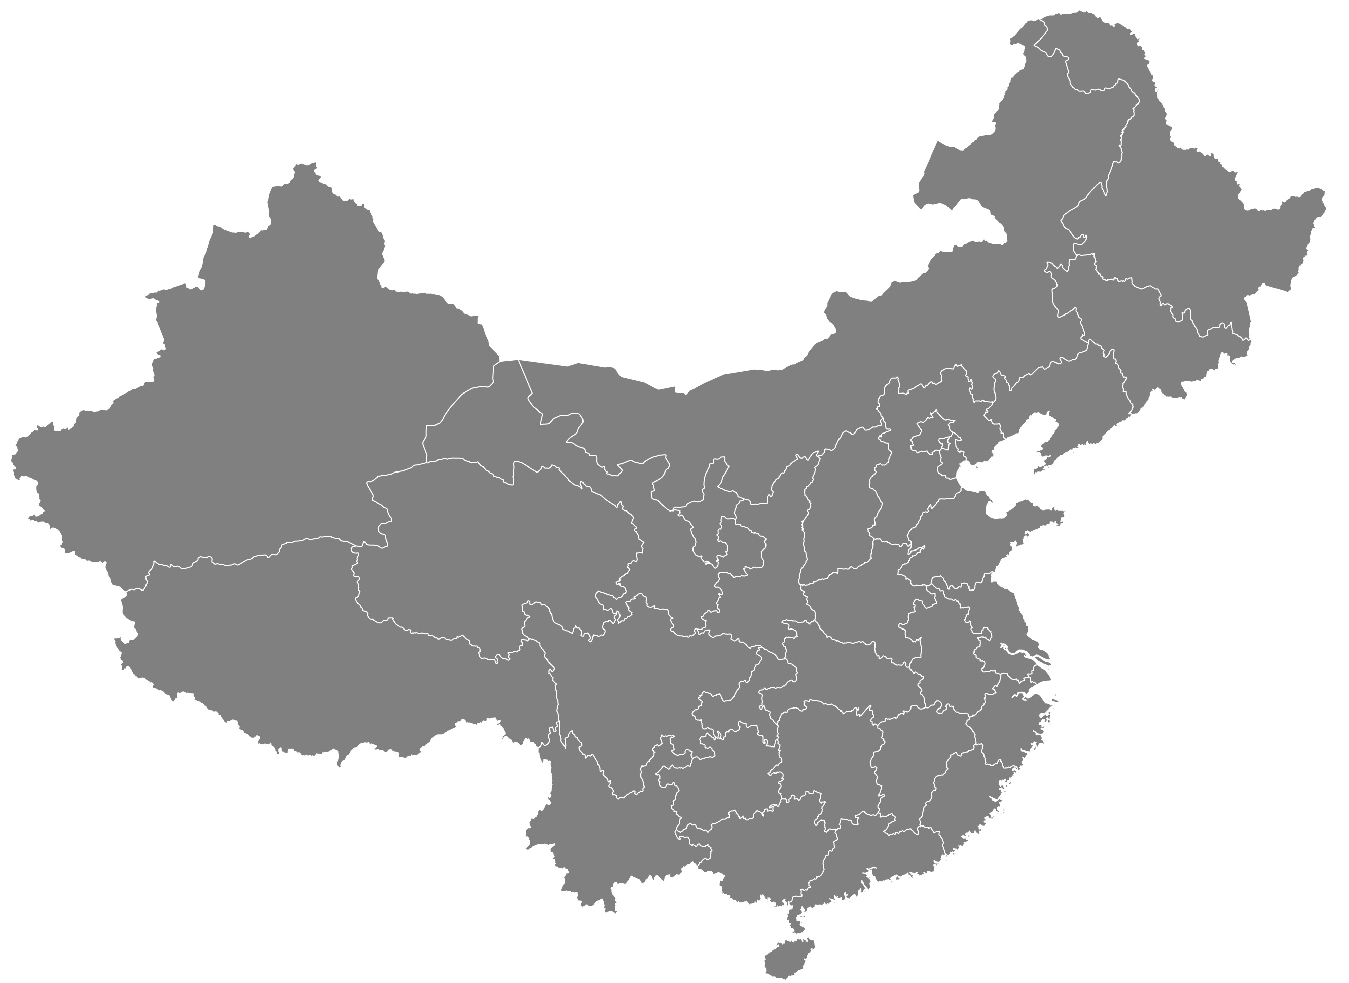
Yuan Renminbi
Shanghai Cooperation Organization (SCO)
China Union Pay
New Development Bank (BRICS)
Chiang Mai Initiative
B
Asia-Pacific Trade Agreement
1
2
3
4
ASEAN - China
Comprehensive Agreement on Investment China/EU
10
8
Australia - China
Chile - China
5
6
7
China - South Korea
Regional Comprehensive Economic Partnership
China - Costa Rica
11
Trade Agreements
China - Georgia
Belt and Road Initiative
9
China - Hong Kong
China - Macao
Dollar / Euro
NATO Central Asia
BRICS
China - Mauritius
China - New Zealand
A
VISA, Mastercard
Asian Infrastructure Investment Bank
China - Singapore
World Bank
China - Iceland
IMF
China - Pakistan
D
E
China - Peru
1
2
3
4
Conference on Interaction and Confidence Measures in Asia
China - Switzerland
Transatlantic Trade and Investment Partnership
10
8
5
6
7
GATT
9
Eurasian Economic Union
Annex 1A Multilateral Agreements on Trade in Goods
WTO
G7/G8
Annex 1B General Agreement on Trade in Services (GATS)
Trans-Pacific Partnership Agreement
Asian Development Bank
11
Legal Texts
Annex 1C Trade-Related Aspects of Intellectual Property Rights (TRIPS)
ASEAN Regional Forum
Annex 2 Dispute Settlement Understanding
A
Multilateral Trading System
B
Annex 3 Trade Policy Review Mechanism
Intrusion of the People's Republic of China
D
Parallel or shadow institutionality
Annex 4 Plurilateral Trade Agreements
E
Parallel or shadow institutionality

